Slide 1
Speedily re-establishing missing elements of children’s identity in emergency situations (Art. 8(2) CRC)
Webinar– February 2025

Slide 2
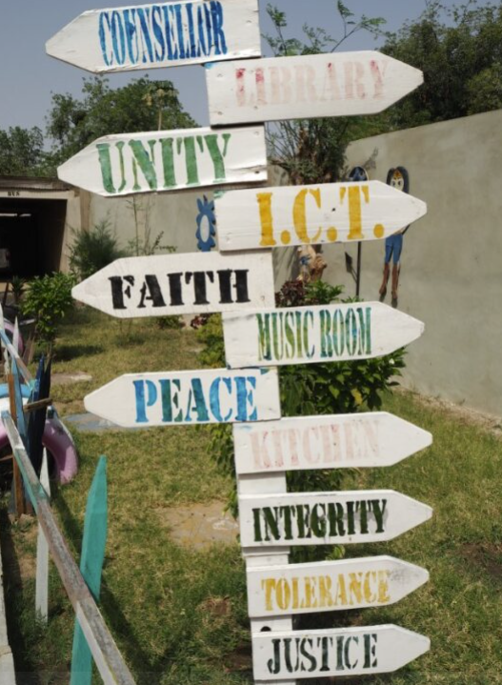
Education & livelihood training as a form of reparation
Co-creation & other forms of participation
Access to legal identity & nationality
Fight against stigmatisation and ostracisation by their communities and families
©Sarah-Eve Hammond / GSF
PRIORITIES – CHILDREN STRATEGY

Slide 3
Psychological harm
Stigmatisation
Discrimination
Depression
Transgenerational harm
Physical harm
HIV
Health conditions from unsuccessful abortion attempts
Lived realities
Captivity
Displacement
Lack of legal identity
Economic hardship
Marie Perrault/ GSF
Children born of CRSV
GSF visit to the interim reparative measures project. Türkiye, July 2023. ©Marie Perrault/ GSF

Slide 4
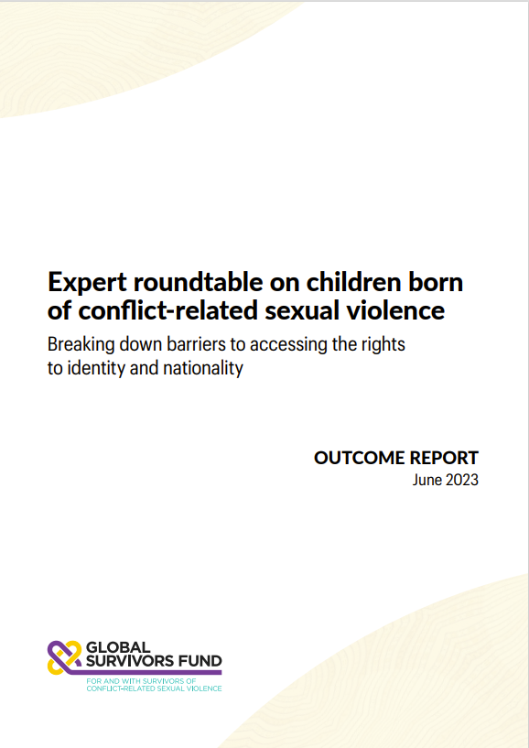
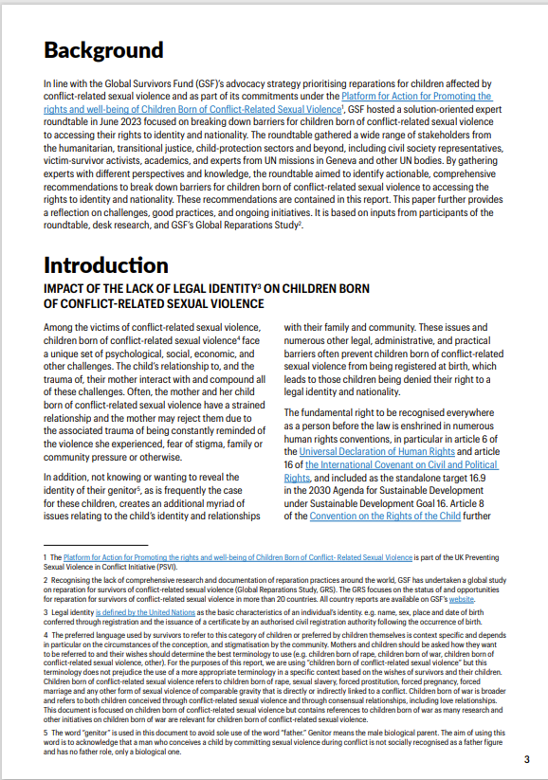
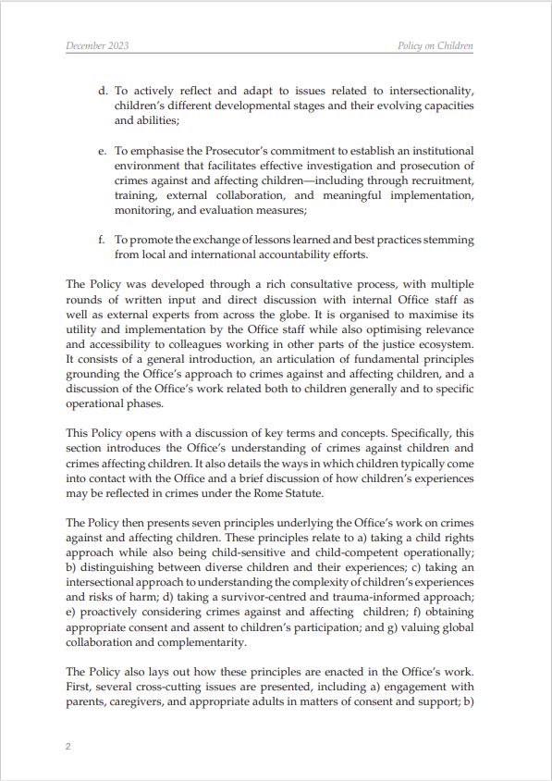
GSF organised a roundtable in June 2023 to identify solutions for eliminating obstacles preventing children born of CRSV from accessing their rights to identity and nationality

Slide 5
THE ISSUE
CHILDREN BORN OF CRSV FACE NUMEROUS LEGAL ADMINISTRATIVE, AND PRACTICAL CHALLENGES
CHILDREN BORN IN A COUNTRY OTHER THAN THEIR MOTHERS HOME COUNTRY MAY ENCOUNTER ADDITIONAL CHALLENGES
IMPACT OF TRAUMA CAN AFFECT THE MOTHER’S ABILITY TO FORMALISE THE CHILD’S IDENTITY
.
.

Slide 6
CONSEQUENCES
IMPACT ON WELLBEING OF CHILDREN
FURTHER EXCLUSION AND VULNERABILITY
Legal identity is generally required to access other human rights and essential services, including access to education, health, social protection, property or inheritance.
Increased vulnerability, exclusion, discrimination, stigmatization, statelessness, additional emotional trauma and economic hardship for children born of CRSV.
INVISIBILITY IN SOCIETY
OBSTACLES TO JUSTICE & REPARATION
It increases their vulnerability to abuse and exploitation, including trafficking, illegal adoption, child labor, child marriage and their recruitment by armed groups and forces.
Some programmes require victims to have a legal identity. Governments do not include these children as a category of victims eligible for reparation or do not recognise them as direct victims.

Slide 7
Legal reforms
Awareness and advocacy campaigns
Targeted interventions
STATEGIES

Slide 8
EQUAL RIGHTS FOR TRANSMISSION OF NATIONALITY
Need for governments to guarantee equal rights between women and men with regard to the transmission of their nationality to their children and their registration and abolish laws requiring proof of marriage for registration.
IDENTITY SHOULD NOT BE PREREQUISITE FOR OTHER RIGHTS
Additionally, governments should reconsider the requirement of legal identity as a prerequisite for access to other rights such as education and health care.
©Marie Perrault/ GSF
RECOMMENDATIONS

Slide 9
RECOGNITION AS DIRECT VICTIMS & ACCESS TO REPARATION
Recognising them as direct victims and provide them access to a remedy and reparation in a victim and child-sensitive manner. Access to one’s right to a legal identity and nationality should be included as a form of reparation.
EDUCATION CAMPAIGNS TARGETED TOWARDS SURVIVORS
Developing education campaigns targeted towards survivors of CRSV and their families and communities to highlight the paramount significance of birth registration for children born of CRSV and their families is essential.
AWARENESS CAIMPAIGNS
Targeting the international community, governments, and communities to promote awareness of the rights and needs of children born from CRSV and their mothers, and the importance of legal identity must intensify.
©Marie Perrault/ GSF
RECOMMENDATIONS

